Slide 1


Lesson 7 What do you do in your free time?
UNIT 2

Slide 2
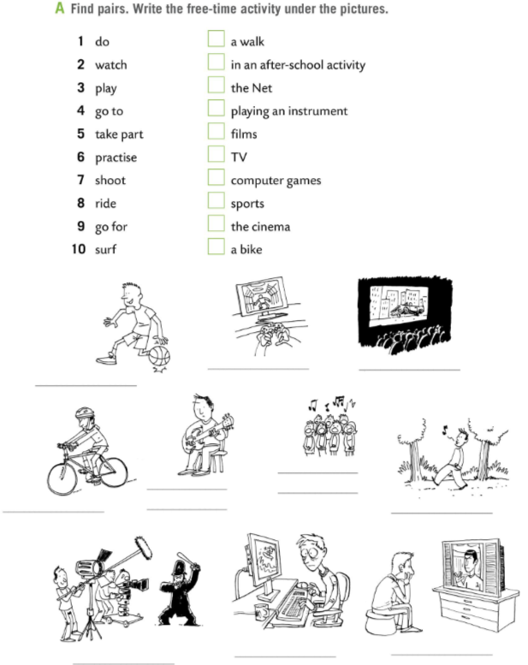
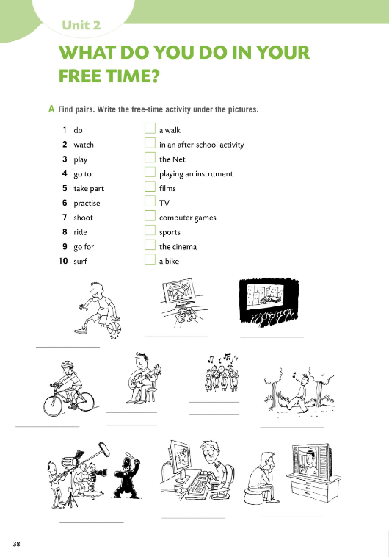

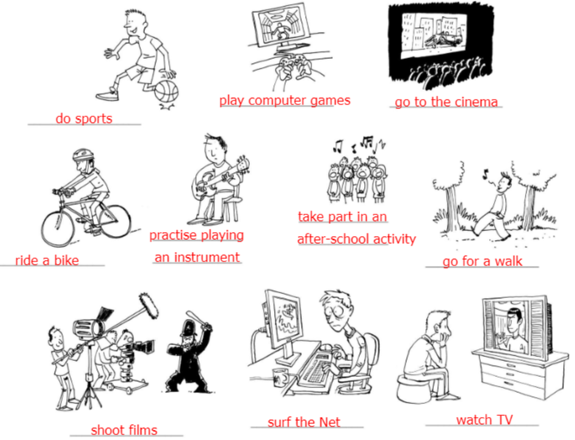
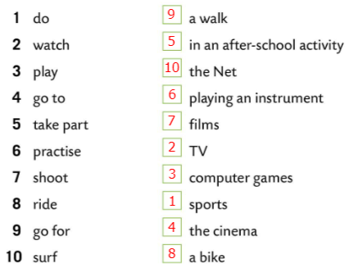
Workbook, page 38.
Find pairs in Task A.
Write the free-time activity under the pictures.
Check.
Play a game and check your knowledge.
https://wordwall.net/play/6452/780/650

Slide 3


Translate the expressions.
do sport – baviti se sportom
watch TV – gledati televiziju
play computer games – igrati računalne igre
go to the cinema – ići u kino
take part in after-school activity – sudjelovati u izvannastavnim aktivnostima
practise playing an instrument – vježbati sviranje instrumenta
shoot films – snimati filmove
ride a bike – voziti bicikl
go for a walk – ići u šetnju
surf the Net – pretraživati na Internetu

Slide 4
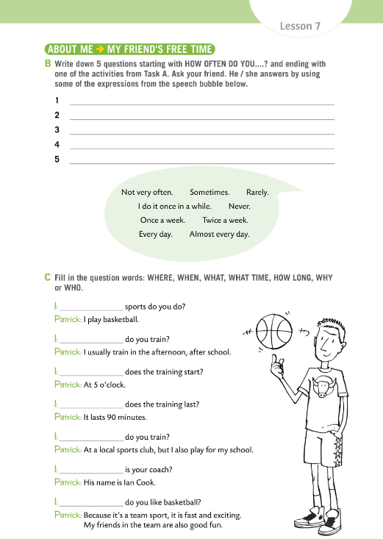
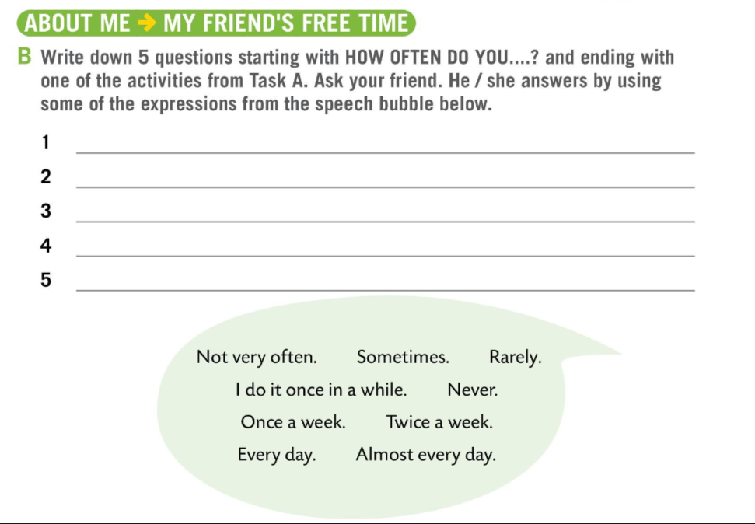
Workbook, page 39.
Write 5 questions starting with HOW OFTEN DO YOU…? and ending with one of the activities from Task A.
Ask your friend. He/She answers by using some of the expressions from the speech bubble.
Check in class.

Slide 5
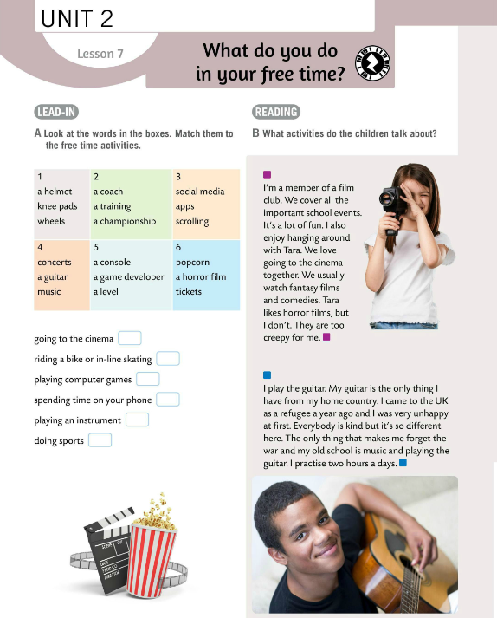
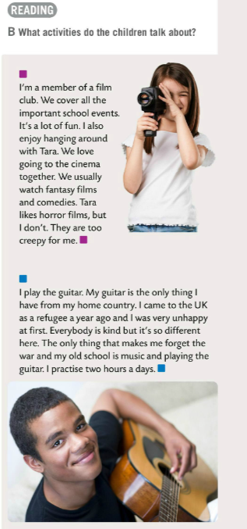
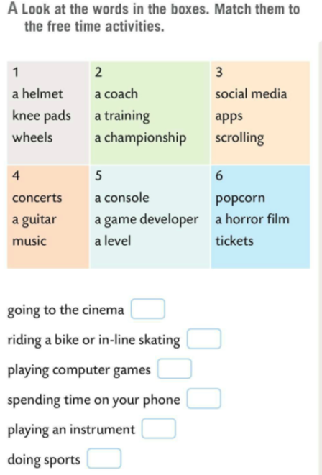
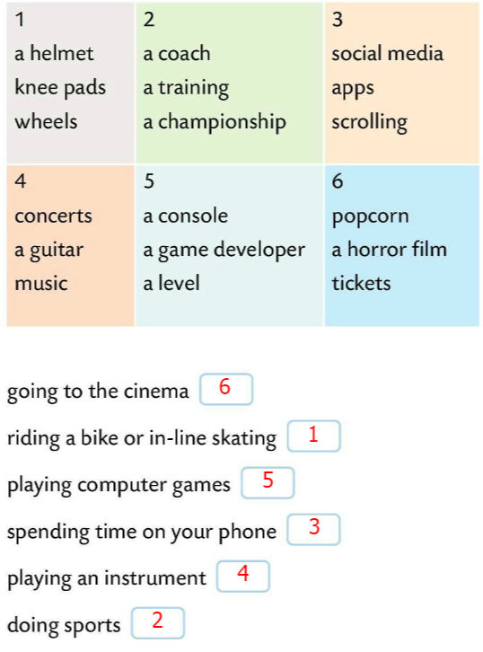
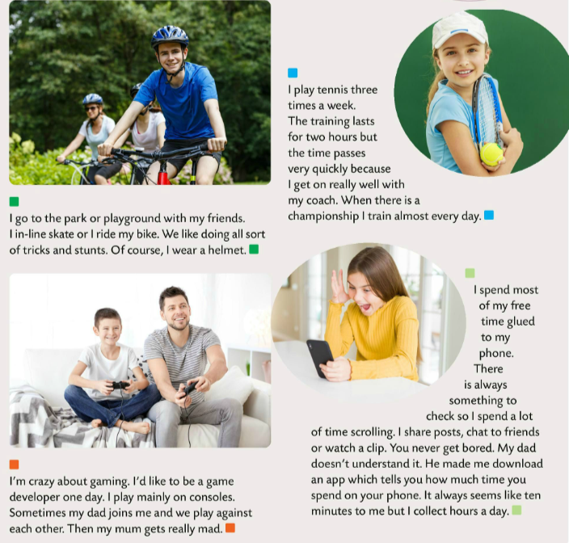
Read the words in Task A. Match the words in the boxes to the free time activities.
Check.
Read the text in Task B. What activities do the children talk about?

Slide 6
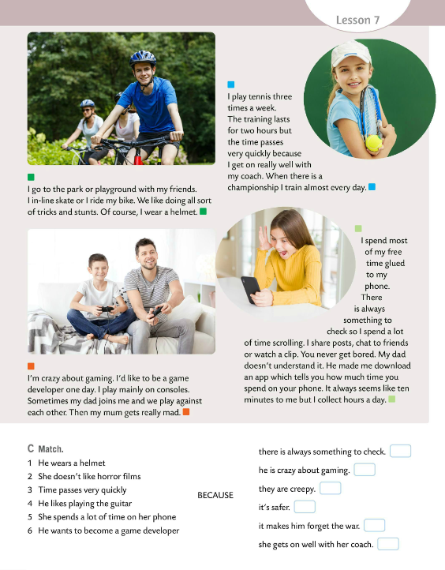
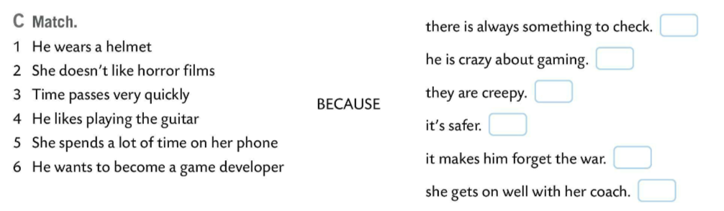
Read the text again.
Match the beginnings and endings of sentences.
Check.
5
6
2
1
4
3

Slide 7
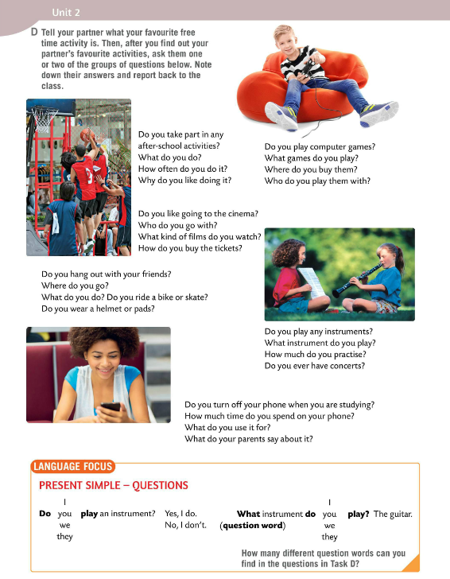
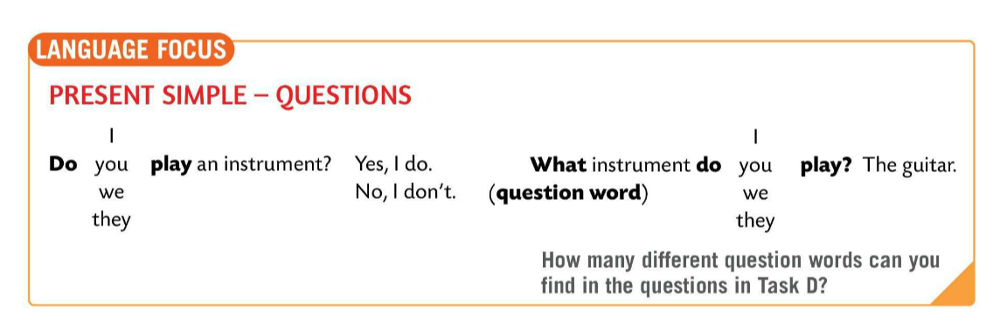
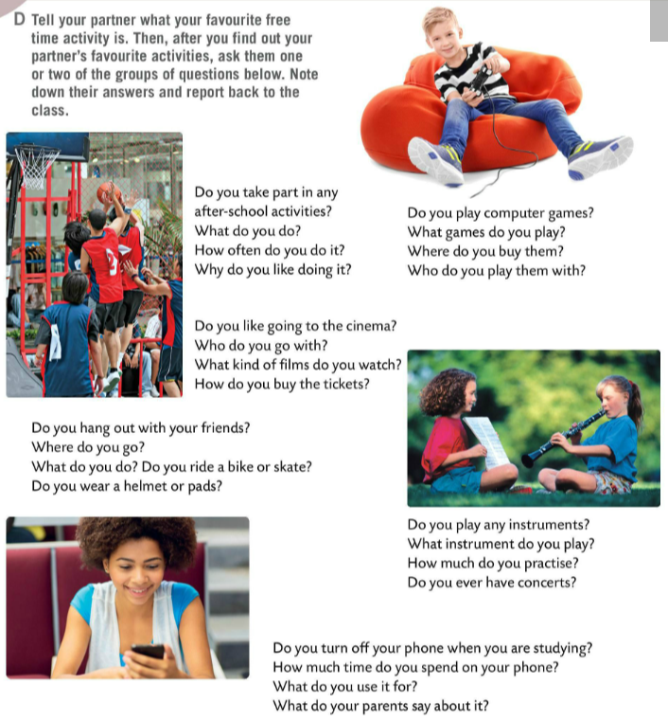
What is your favourite free time activity?
Tell it to your partner and try to find out what your partner’s favourite activity is. Choose two groups of questions in Task D and note down their answers.
Report back to the class.
LANGUAGE FOCUS – YES/NO QUESTIONS
FORM
We form Yes/No questions with an auxiliary verb DO at the beginning of the sentence.
Do you like summer?
Kratka pitanja (da/ne) tvorimo tako da na početak rečenice stavimo pomoćni glagol DO.

Slide 8
LANGUAGE FOCUS – YES/NO QUESTIONS
FORM
Subject is in the second place (I, YOU, WE, THEY) and after the subject comes the verb without the –s or -es.
Do you like summer?
Subjekt (I, YOU, WE, THEY) se nalazi je na drugome mjestu upitne rečenice. Glagol koji dolazi nakon subjekta nema nastavak – s ili –es.

Slide 9
Wh-questions FORM
question words (what, where, who…) + auxiliary verb DO + SUBJECT (I, YOU, WE, THEY) + VERB .
What do you play?
Wh-pitanja tvorimo na način da na početak stavljamo upitnu riječ (what, where, who…), a zatim dodajemo pomoćni glagol DO, subjekt i glagol.
How many different question words can you find in Task D?

Slide 10
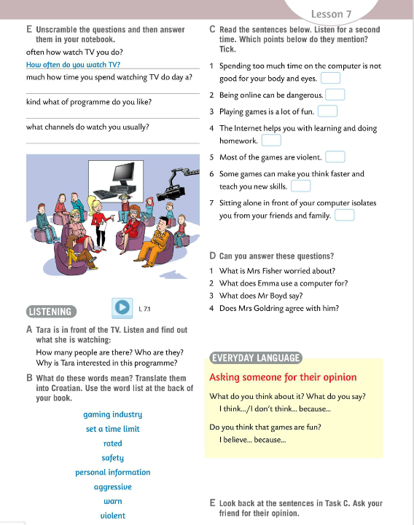
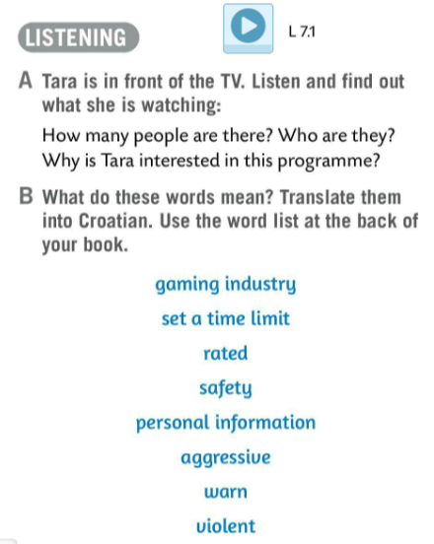
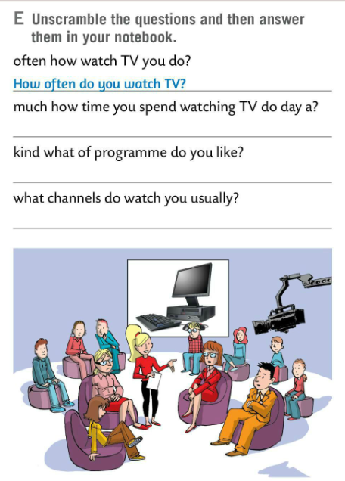

Unscramble the questions in Task E and answer them.
Check.
How much time a day do you spend watching TV?
Tara is in front of TV.
Listen carefully and find out what she is watching.
What kind of programmes do you like?
What channels do you usually watch?
Listen again and answer the questions in Task A.
Check.
There are five people.
They are: the TV host, Mrs Goldring, Mr Boyd, Emma, and Mrs Fischer.
Tara was interested in the programme because her friend Emma was in it.

Slide 11
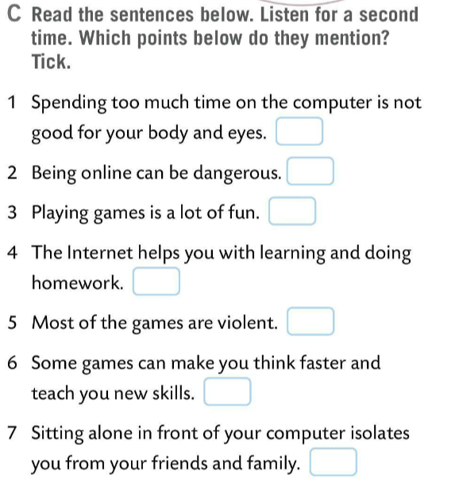

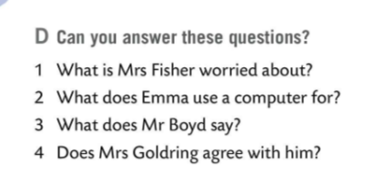
What do words in Task B mean? Translate them into Croatian. Use the word list at the back of your book.
Check.
Read the sentences in Task C. Listen for a third time and tick the points the speakers mention.
industrija videoigara
postaviti vremensko ograničenje
Mrs Fischer is worried about his safety online.
Check.
S oznakom namijenjenosti (odnosi se na računalne igre)
Emma uses computer for homework, downloading music, watching video clips, and playing games.
sigurnost
Mr Boyd says that most of the games are rated. There are some good games that can teach you new skills.
osobni podatci
Can you answer the questions in Task D?
nasilno, agresivno
She doesn’t, because playing video games isolates you from your family and friends..
upozoriti
Check.
nasilan

Slide 12
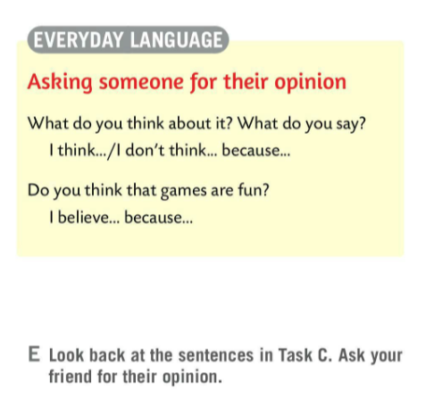
EVERYDAY LANGUAGE
How do we ask someone for their opinion?
Kako pitamo nekoga za mišljenje?
Look back at the sentences in Task C. Ask your friends for their opinion.

Slide 13
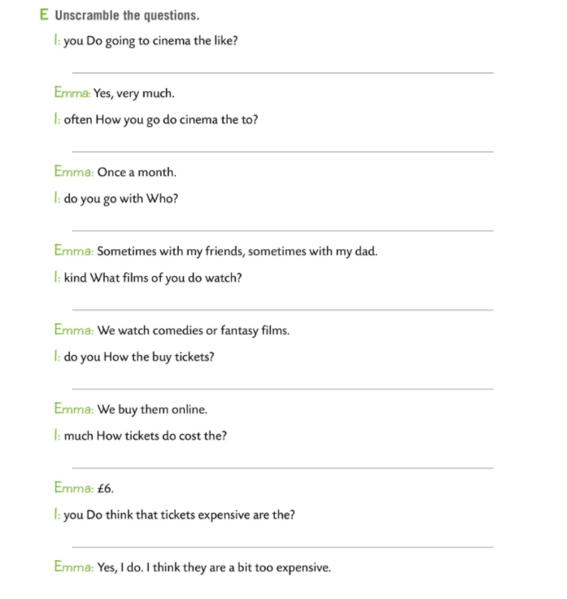
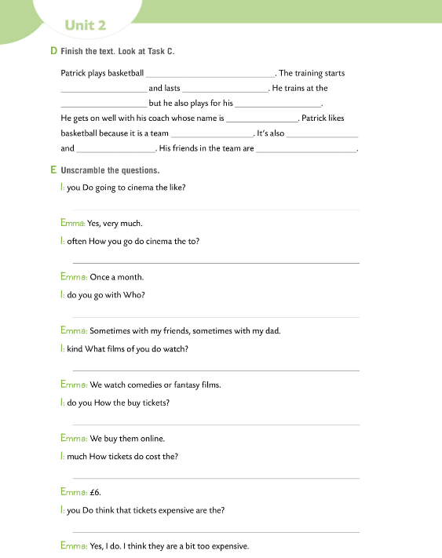
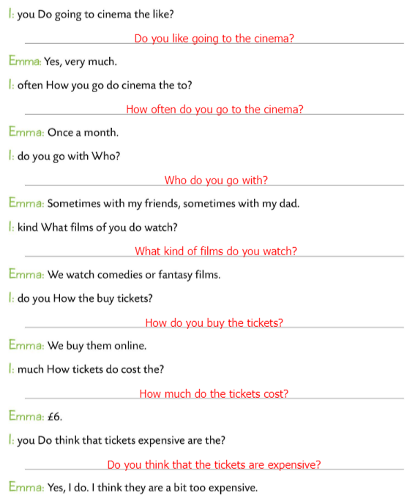
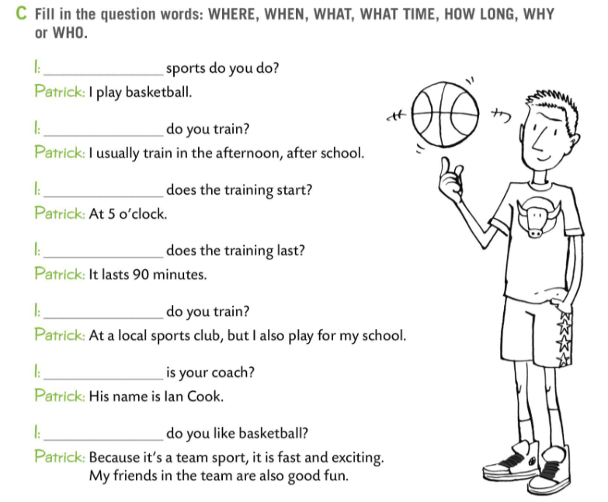
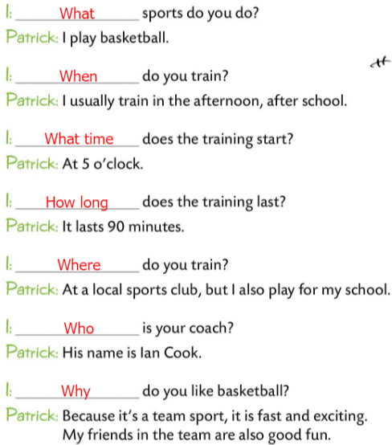
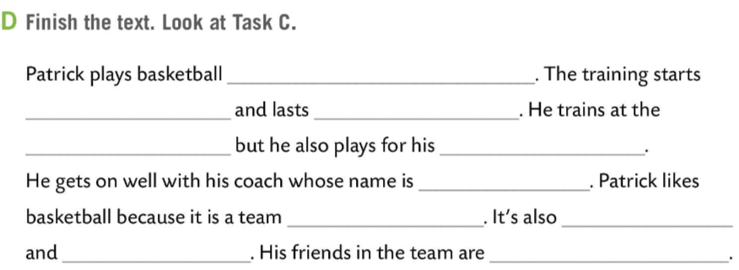
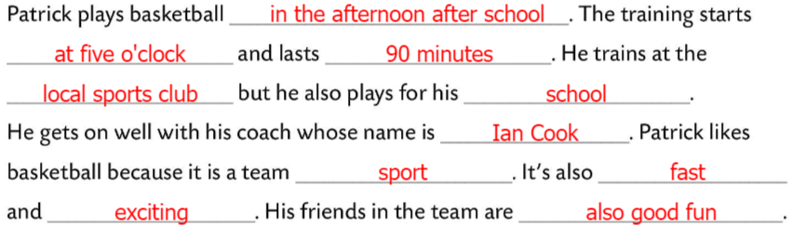
Workbook, pages 39 & 40.
Fill in the question words in Task C with: WHERE, WHEN, WHAT, WHAT TIME, HOW LONG, WHY or WHO.
Check.
Finish the text in Task D. Look at Task C.
Check.
Unscramble the questions in Task E.
Check.

Slide 14
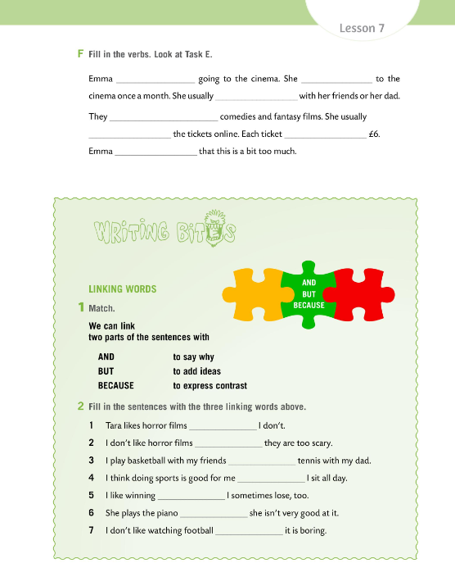
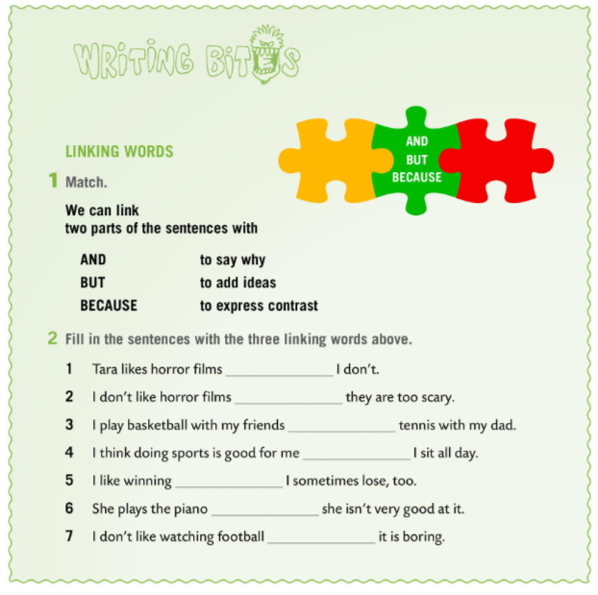
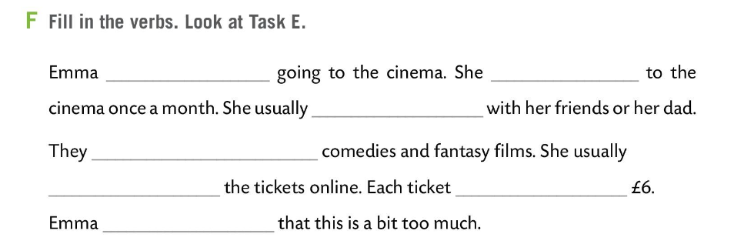
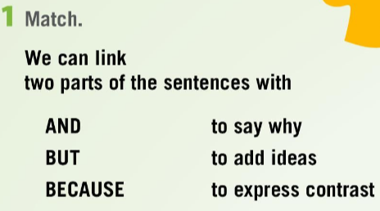
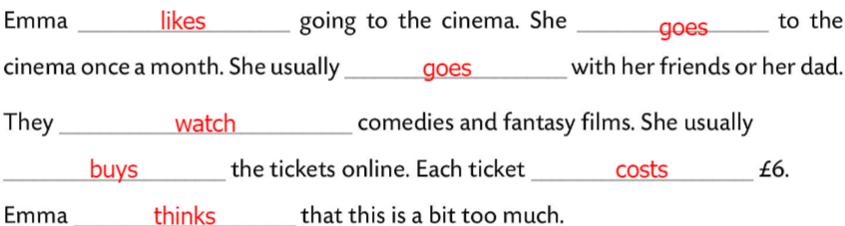
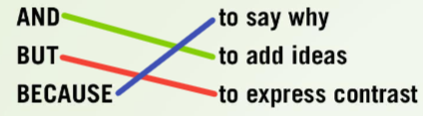
Workbook, page 41.
Fill in the sentences in Task F with the verbs. Look at Task E.
Check.
Match the LINKING WORDS in Task 1 to get definitions.
Check.
*Dva dijela rečenice možemo povezati s VEZNICIMA (LINKING WORDS )
AND (I) – za dodavanje ideja,
BUT (ALI) – za izražavanje suprotnosti i
BECAUSE (JER, ZBOG, ZATO ŠTO) – za izražavanje uzroka.

Slide 15
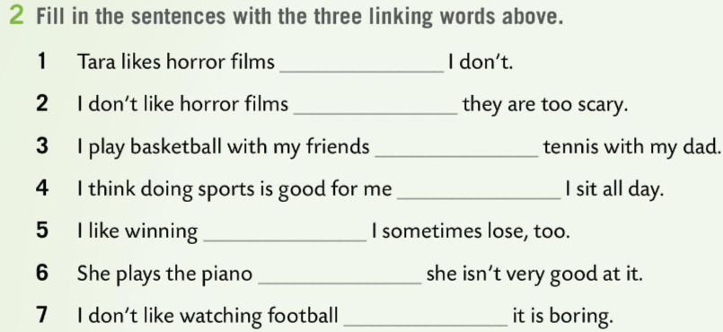
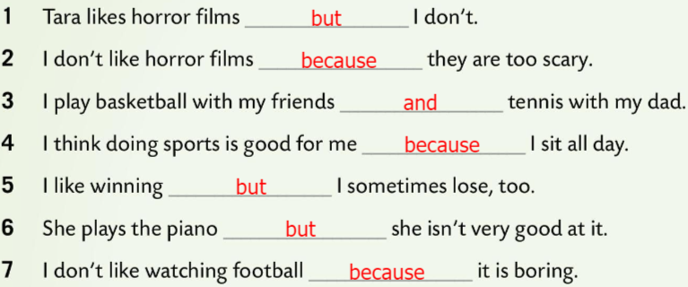
Workbook, page 41.
Fill in the sentences with the three linking words.
Check.

Slide 16
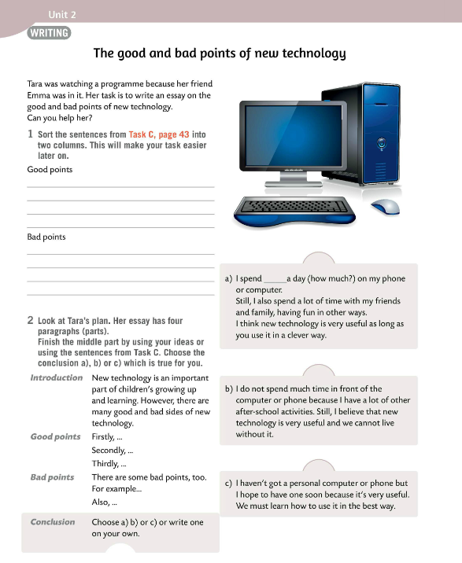
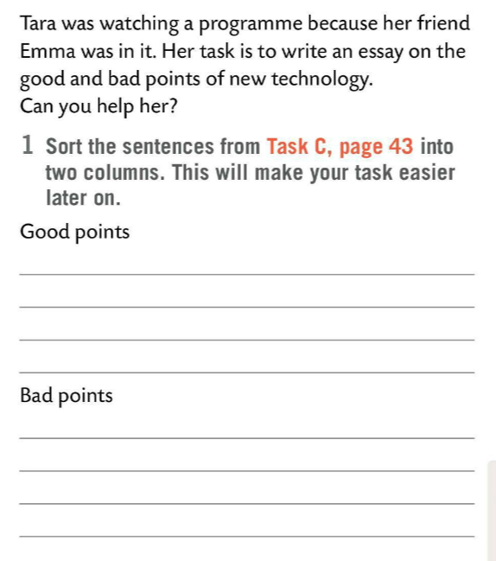
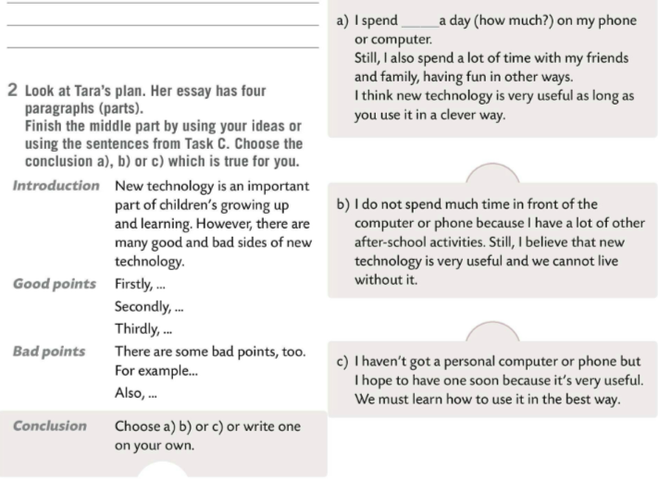
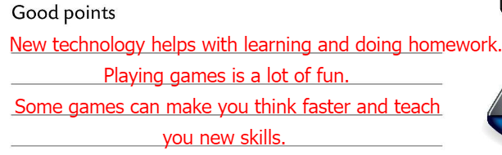
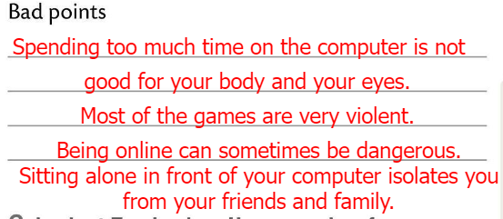
Can you help Tara?
Do Task 1?
Sort out the sentences from Task C (page 43) into two columns.
Check.
Look at Tara’s plan. Her essay has four paragraphs (parts).
Finish the middle part by using your own ideas or sentences from Task C. Choose conclusion a) , b) or c) or write one on you own.

